Slide 1


http://www.comp.nus.edu.sg/~cs2100/
CS2100
Recitation 10
Sequential Circuits
31 March 2025
(Make-up on 27 March 2025)
Aaron Tan

Slide 2
Contents
Latches
Flip-flops
Analysis of Sequential Circuits
Design of Sequential Circuits
Quizzes
Selected Past Years’ Exam Questions
AY2015/16 Sem1 Q7
AY2020/21 Sem2 Q12

Slide 3
1. Introduction
2 weeks ago…
Two classes of logic circuits
Combinational
Sequential
Combinational Circuit
Each output depends entirely on the immediate (present) inputs.
Sequential Circuit
Each output depends on both present inputs and state.
Combinational
Logic
Combinational
Logic
inputs
: :
: :
outputs
inputs
: :
: :
outputs
Memory

Slide 4
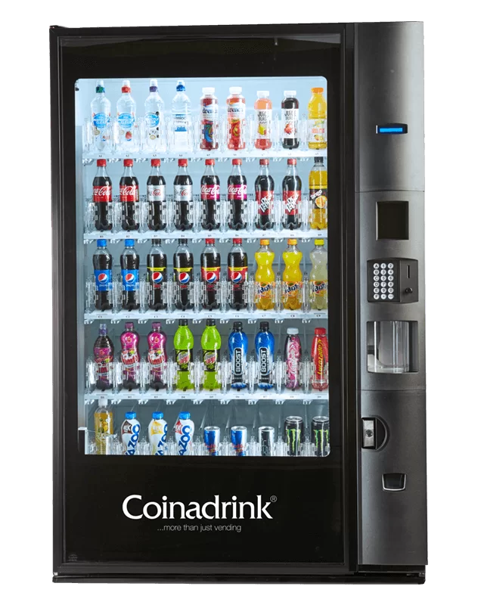



Slide 5
summary
Latches

Slide 6
3.1 S-R Latch (2/3)
Key: When tracing a lach/flip-flop, do it 3 rounds.
Active-high input S-R latch:
1
0
1
0
0
R
1
1
0
0
Q
0
Q'
0
0
1
1
1
0
0
0
0
1
S
Block diagram:
Characteristic table:
S
R
Q
Q'

Slide 7
3.1 Active-Low S-R Latch
(You may skip this slide.)
What we have seen is active-high input S-R latch.
There are active-low input S-R latches, where NAND gates are used instead. See diagram on the left below.
S
Q
S
Q
R
Q'
R
Q'
In this case,
when R=0 and S=1, the latch is reset (i.e. Q becomes 0)
when R=1 and S=0, the latch is set (i.e. Q becomes 1)
when S=R=1, it is a no-change command.
when S=R=0, it is an invalid command.
Sometimes, we use the alternative gate diagram for the NAND gate. See diagram on the right above. (This appears in more complex latches/flip-flops in the later slides.)
(Sometimes, the inputs are labelled as S' and R'.)

Slide 8
3.1 Active-High vs Active-Low S-R Latch
(Active-high) S-R latch
Active-low S-R latch
R
S
Q
Q
Q'
R
Q'
S
S | R | Q(t+1) | Command
0 | 0 | Q(t) | No change
0 | 1 | 0 | Reset
1 | 0 | 1 | Set
1 | 1 | ? | Invalid
S | R | Q(t+1) | Command
1 | 1 | Q(t) | No change
1 | 0 | 0 | Reset
0 | 1 | 1 | Set
0 | 0 | ? | Invalid

Slide 9
3.1 Gated S-R Latch
S-R latch + enable input (EN) and 2 NAND gates → a gated S-R latch.
S
Q
S
EN
R
Q
Q'
EN
Q'
R
Outputs change (if necessary) only when EN is high.
Characteristic table:
EN | S | R | Q(t+1) | Command
1 | 0 | 0 | Q(t) | No change
1 | 0 | 1 | 0 | Reset
1 | 1 | 0 | 1 | Set
1 | 1 | 1 | ? | Invalid
0 | X | X | Q(t)

Slide 10
3.2 Gated D Latch (1/2)
Make input R equal to S' → gated D latch.
D latch eliminates the undesirable condition of invalid state in the S-R latch.
D
Q
D
EN
Q
Q'
EN
Q'
Characteristic table:

Slide 11
summary
Flip-Flops

Slide 12
4. Flip-flops (1/2)
Flip-flops are synchronous bistable devices.
Output changes state at a specified point on a triggering input called the clock.
Change state either at the positive (rising) edge, or at the negative (falling) edge of the clock signal.
Clock signal
Positive edges
Negative edges

Slide 13
4.1 S-R Flip-flop
S-R flip-flop: On the triggering edge of the clock pulse,
R = HIGH and S = LOW ➔ Q becomes LOW (RESET state)
S = HIGH and R = LOW ➔ Q becomes HIGH (SET state)
Both R and S are LOW ➔No change in output Q
Both R and S are HIGH ➔Invalid!
Characteristic table of positive edge-triggered S-R flip-flop:
S
C
R
Q
Q'
X = irrelevant (“don’t care”)
↑ = clock transition LOW to HIGH

Slide 14
4.2 D Flip-flop (1/2)
D flip-flop: Single input D (data). On the triggering edge of the clock pulse,
D = HIGH ➔ Q becomes HIGH (SET state)
D = LOW ➔ Q becomes LOW (RESET state)
Hence, Q “follows” D at the clock edge.
Convert S-R flip-flop into a D flip-flop: add an inverter.
D
S
C
R
Q
Q'
CLK
A positive edge-triggered D flip-flop formed with an S-R flip-flop.
↑ = clock transition LOW to HIGH

Slide 15
4.3 J-K Flip-flop (2/2)
J-K flip-flop circuit:
J
Q
Pulse transition detector
CLK
Q'
K
Characteristic table:
Q(t+1) = ?
J∙Q' + K'∙Q


Slide 16
4.4 T Flip-flop
T flip-flop: Single input version of the J-K flip-flop, formed by tying both inputs together.
T
T
Q
J
C
K
Q
Q'
Pulse transition detector
CLK
CLK
Q'
Characteristic table:
Q(t+1) = ?
T∙Q' + T'∙Q


Slide 17
5. Asynchronous Inputs (1/2)
S-R, D and J-K inputs are synchronous inputs, as data on these inputs are transferred to the flip-flop’s output only on the triggered edge of the clock pulse.
Asynchronous inputs affect the state of the flip-flop independent of the clock; example: preset (PRE) and clear (CLR) [or direct set (SD) and direct reset (RD)].
When PRE=HIGH, Q is immediately set to HIGH.
When CLR=HIGH, Q is immediately cleared to LOW.
Flip-flop in normal operation mode when both PRE and CLR are LOW.

Slide 18
5. Asynchronous Inputs (2/2)
A J-K flip-flop with active-low PRESET and CLEAR asynchronous inputs.
PRE
PRE
J
Q
J
C
K
Q
Q'
Pulse transition detector
CLK
K
Q'
CLR
CLR
CLK
PRE
CLR
J = K = HIGH
Q
Preset
Toggle
Clear

Slide 19
COMMON Questions
From previous semester

Slide 20
Q1: How does slide 9 of lect 19 work? Why is it that both R and S are high considered an invalid input?
A: It has been illustrated that when both R and S are high, the output Q and Q’ are the same, which violates the definition of a latch/flip-flop.
Q2: Does Q(t+1), Q+ and Q’ all mean the same thing?
A: Q(t) and Q(t+1) mean present state and next state respectively. They can also be referred to simply as Q and Q+ respectively. So, Q = Q(t), and Q+ = Q(t+1).
Q’ is the complement of Q. Therefore, Q’ is not the same as Q (in fact, it is the negation/opposite of Q), nor is it the same as Q+ (it has no relationship to Q+).
Q3: L19 slide 10, the outputs are redirected as inputs, and to get outputs we need inputs first. How does the whole thing work as it seems like a never-ending cycle.
A: If there isn’t a clock, will be a “never-ending cycle”. The clock provides synchronisation. The flip flop acts only when it is activated (by the rising edge or falling edge of the clock).

Slide 21
Q4: Why is there a circle at Q’ output on the flip flop?
S
C
R
Q
Q'
D
C
Q
Q'
J
C
K
Q
Q'
Positive edge-triggered flip-flops
S
C
R
Q
Q'
D
C
Q
Q'
J
C
K
Q
Q'
Negative edge-triggered flip-flops
A: Just a labelling convention, to remind users that the output (Q’) is the negation of Q.

Slide 22
Q5: What do Q and Q’ represent on the flip flop?
S
C
R
Q
Q'
D
C
Q
Q'
J
C
K
Q
Q'
Positive edge-triggered flip-flops
A: Q is the state of the flip-flop and Q’ is the negation of Q.
A flip-flop is a one-bit memory unit; when it stores a 0 it is said to be in the reset state; when it stores a 1 it is in the set state. The Q output of a flip-flop determines the state it is in.

Slide 23
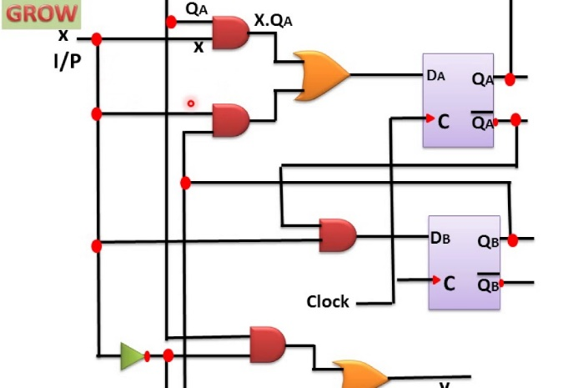
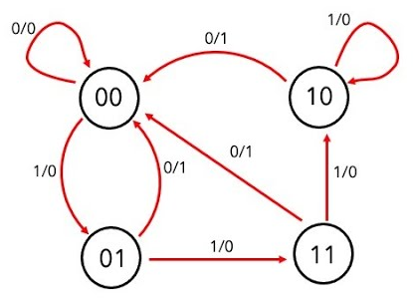
Analysis
Design
Uses flip-flop characteristic tables.
Uses flip-flop excitation tables.
Logic circuit
State diagram
Just for illustration. The state diagram here does not correspond to the logic circuit.

Slide 24
summary
Analysis of Sequential Circuits

Slide 25
6.1 Flip-flop Characteristic Tables
Each type of flip-flop has its own behaviour, shown by its characteristic table.

Slide 26
6.2 Analysis: Example #2 (1/3)
Given Figure 2, a sequential circuit with two J-K flip-flops A and B, and one input x.
J
Q
A
x
K
Q'
J
Q
B
K
Q'
Figure 2
CP
Obtain the flip-flop input functions from the circuit:
JA = B JB = x'
KA = B∙x' KB = A'∙x + A∙x' = A ⊕ x

Slide 27
6.2 Analysis: Example #2 (2/3)
JA = B JB = x'
KA = B∙x' KB = A'∙x + A∙x' = A ⊕ x
Fill the state table using the above functions, knowing the characteristics of the flip-flops used.
0 1
0 0
1 1
1 0
1 1
1 0
0 0
1 1


Slide 28
6.2 Analysis: Example #2 (3/3)
Draw the state diagram from the state table.
1
1
0
11
00
0
0
0
01
1
10
1


Slide 29
summary
Design of Sequential Circuits

Slide 30
6.3 Flip-flop Excitation Tables (1/2)
Excitation tables: given the required transition from present state to next state, determine the flip-flop input(s).
JK Flip-flop
SR Flip-flop
D Flip-flop
T Flip-flop

Slide 31
6.4 Design: Example #1 (1/5)
Given the following state diagram, design the sequential circuit using JK flip-flops.
0
Questions:
How many flip-flops are needed?
How many input variable are there?
00
1
1
1
01
11
0
Answers:
Two flip-flops. Let’s call them A and B.
One input variable. Let’s call it x.
0
1
10
0


Slide 32
6.4 Design: Example #1 (2/5)
Circuit state/excitation table, using JK flip-flops.
0
00
1
1
1
01
11
0
0
1
10
0
0 X
0 X
1 X
X 1
X 0
0 X
1 X
X 0
X 1
0 X
1 X
0 X
X 0
JK Flip-flop’s
excitation table.
X 0
X 0
X 1


Slide 33
6.4 Design: Example #1 (3/5)
Block diagram.
A'
A
B'
B
Q'
Q
Q'
Q
K
J
K
J
CP
KA
JA
KB
JB
A'
Combinational
circuit
A
External
output(s)
(none)
B
B'
x
External
input(s)
What are to go in here?

Slide 34
6.4 Design: Example #1 (4/5)
From state table, get flip-flop input functions.
Bx
B
A
00 01 11 10
0
1
1
A
X
X
X
X
x
JA = B∙x'
Bx
B
A
00 01 11 10
B
B
0
1
X
X
X
X
Bx
Bx
A
00 01 11 10
A
00 01 11 10
A
1
0
1
1
X
X
0
1
X
X
1
x
A
1
X
X
A
X
X
1
KA = B∙x
x
x
JB = x
KB = (A ⊕ x)'

Slide 35
6.4 Design: Example #1 (5/5)
Flip-flop input functions:
JA = B∙x' JB = x
KA = B∙x KB = (A ⊕ x)'
Logic diagram:
A
B
Q'
Q
Q'
Q
K
J
K
J
CP
x

Slide 36
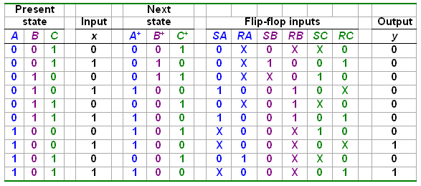
6.4 Design: Example #3 (1/4)
Design involving unused states.
Are there other unused states?
Given these
Derive these
Unused state 000:

Slide 37
6.4 Design: Example #3 (2/4)
From state table, obtain expressions for flip-flop inputs.
Cx
C
Cx
C
AB
00 01 11 10
AB
00 01 11 10
00
01
11
10
X
X
0
0
00
01
11
10
X
X
X
X
0
1
1
0
X
0
0
X
B
B
X
X
X
X
X
X
X
X
A
A
X
X
X
0
0
0
0
1
SA = B∙x
RA = C∙x'
x
x
Cx
C
Cx
C
AB
00 01 11 10
AB
00 01 11 10
00
01
11
10
X
X
1
0
00
01
11
10
X
X
0
X
X
0
0
0
0
1
1
1
B
B
X
X
X
X
X
X
X
X
A
A
0
0
0
0
X
X
X
X
SB = A'∙B'∙x
x
x
RB = B∙C + B∙x

Slide 38
6.4 Design: Example #3 (3/4)
From state table, obtain expressions for flip-flop inputs (cont’d).
Cx
C
Cx
C
AB
00 01 11 10
AB
00 01 11 10
00
01
11
10
X
X
0
X
00
01
11
10
X
X
1
0
1
0
0
X
0
X
1
0
B
B
X
X
X
X
X
X
X
X
A
A
SC = x'
1
0
0
X
0
X
1
0
RC = x
x
x
Cx
C
AB
00 01 11 10
00
01
11
10
X
X
0
0
0
0
0
0
B
X
X
X
X
A
0
0
1
1
y = A∙x
x

Slide 39
6.4 Design: Example #3 (4/4)
From derived expressions, draw the logic diagram:
SA = B∙x SB = A'∙B'∙x SC = x' y = A∙x
RA = C∙x' RB = B∙C + B∙x RC = x
y
x
S
Q
A
R
Q'
A'
S
Q
B
R
Q'
B'
S
Q
C
R
Q'
CP

Slide 40
Self-Correcting Circuits (1/4)
When a circuit has unused states, these unused states are considered to be “invalid”.
Suppose we have a circuit with 2 flip-flops where states 0 to 2 are used. State 3 is unused and considered to be “invalid”.
On the following pages we see two possible state diagrams for this circuit.

Slide 41
Self-Correcting Circuits (2/4)
Case 1: Non-self-correcting Circuit:
If the circuit finds itself in state 3 (e.g. due to a glitch), it will never transit into a valid state (state 0, 1, or 2).
Case 2: Self-Correcting Circuit
A circuit that will (eventually) find its way back to a valid state.
Here even if the circuit finds itself in state 3, it will transit to a valid state (either state 1 or 2)
0
0
0
0
00
01
00
01
1
1
0
1
0
1
0
10
11
10
11
1
1
1
0,1

Slide 42
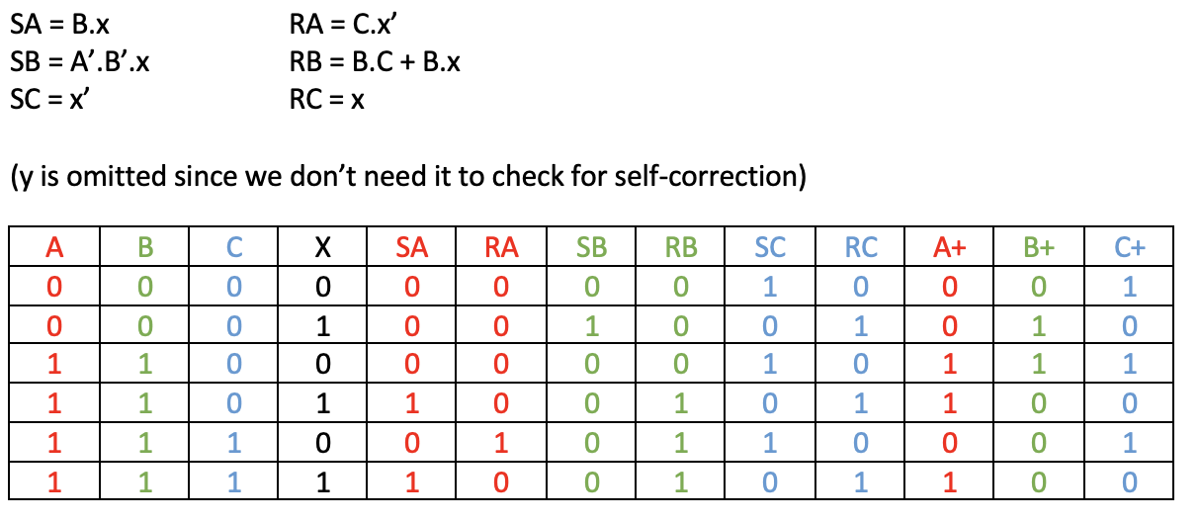
Self-Correcting Circuits (3/4)
Is Design Example #3 self-correcting?
We recreate the state table for the invalid states and see if they lead to any valid states:
Valid states: 1, 2, 3, 4, 5.
Invalid states: 0, 6, 7.

Slide 43
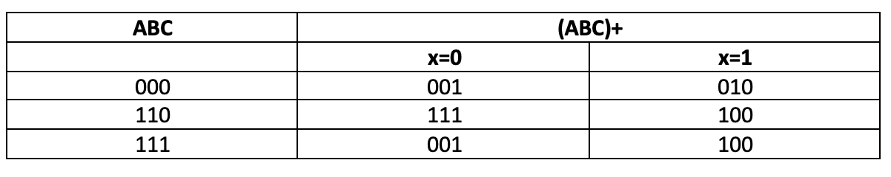
Self-Correcting Circuits (4/4)
Is Design Example #3 self-correcting?
The transitions for the invalid states is summarized below:
We can see that every invalid state eventually transits to some valid state, hence this circuit is self-correcting.
Valid states: 1, 2, 3, 4, 5.
Invalid states: 0, 6, 7.

Slide 44
QnA Q2:
Some of the tutorial qns require very long truth table + kmap which I feel is almost impossible to draw quickly during exam.
Any tips to be faster?

Slide 45
QnA Topic 8
From previous semester:
Q7. hi prof, can you go through the memory array portion the 4k x 8 ram portion

Slide 46
7.3 Memory Cell
A single memory cell of the static RAM has the following logic and block diagrams:
Select
Select
R
S
Input
Q
Output
Input
BC
Output
Read/Write
Read/Write
Logic diagram
Block diagram

Slide 47
7.4 Memory Arrays (3/4)
Address
Input data
Lines
Lines
8 lines
11 10
0 – 9
0–1023
DATA (8)
ADRS (10)
CS
RW
(8)
2x4 decoder
Building a 4K x 8bits RAM using 1K x 8bits RAMs.
1K x 8
S₀
S₁
0
1
2
3
1024 – 2047
DATA (8)
ADRS (10)
CS
RW
(8)
4K locations →12-bit address.
1K x 8
2048 – 3071
Read/write
DATA (8)
ADRS (10)
CS
RW
(8)
Input data
1K x 8
Address
10 lines
8 lines
3072 – 4095
DATA (8)
ADRS (10)
CS
RW
(8)
DATA (8)
ADRS (10)
CS
RW
(8)
Enable
1K x 8
Read/write
1K x 8
Output data
1K x 8bits RAM
Output data
8 lines

Slide 48
7.4 Memory Arrays (4/4)
Read/write control line not included in this diagram.
21-bit
A
addresses
19-bit internal chip address
A
0
1
A
19
A
20
2-bit
decoder
512K x 8 memory chip
512k X 8
memory chip
D
D
D
D
31-24
23-16
15-8
7-0
19-bit
address
8-bit data
input/output
2M × 32 memory module
Using 512K × 8 memory chips.
Chip select

Slide 49
Past YEARs’ QUESTIONS
Sequential Circuits
AY2015/16 Sem1 Q7
AY2020/21 Sem2 Q12

Slide 50
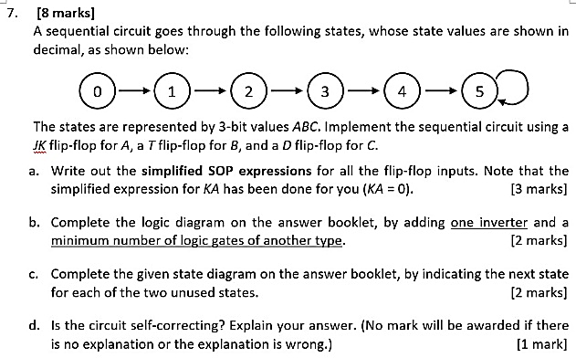
AY2015/16 Sem1 Q7

Slide 51
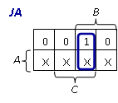
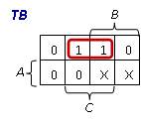
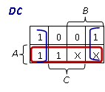
AY2015/16 Sem1 Q7
JK flip-flop excitation table
A | B | C | A⁺ | B⁺ | C⁺ | JA | KA | TB | DC
0 | 0 | 0 | 0 | 0 | 1
0 | 0 | 1 | 0 | 1 | 0
0 | 1 | 0 | 0 | 1 | 1
0 | 1 | 1 | 1 | 0 | 0
1 | 0 | 0 | 1 | 0 | 1
1 | 0 | 1 | 1 | 0 | 1
1 | 1 | 0
1 | 1 | 1
0 X
0
1
0
1
0
1
1
0 X
1
JA = B⋅C
TB = A'⋅C
DC = A+C'
0 X
0
1 X
1
KA = 0
X 0
0
X 0
0
X X X X X X X
X X X X X X X

Slide 52
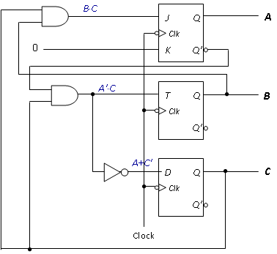
AY2015/16 Sem1 Q7
JA = B⋅C
TB = A'⋅C
DC = A+C'
KA = 0
A | B | C | A⁺ | B⁺ | C⁺ | JA | KA | TB | DC
0 | 0 | 0 | 0 | 0 | 1 | 0 | X | 0 | 1
0 | 0 | 1 | 0 | 1 | 0 | 0 | X | 1 | 0
0 | 1 | 0 | 0 | 1 | 1 | 0 | X | 0 | 1
0 | 1 | 1 | 1 | 0 | 0 | 1 | X | 1 | 0
1 | 0 | 0 | 1 | 0 | 1 | X | 0 | 0 | 1
1 | 0 | 1 | 1 | 0 | 1 | X | 0 | 0 | 1
1 | 1 | 0 | X | X | X | X | X | X | X
1 | 1 | 1 | X | X | X | X | X | X | X

Slide 53
AY2015/16 Sem1 Q7
JA = B⋅C
TB = A'⋅C
DC = A+C'
KA = 0
A | B | C | A⁺ | B⁺ | C⁺ | JA | KA | TB | DC
0 | 0 | 0 | 0 | 0 | 1 | 0 | X | 0 | 1
0 | 0 | 1 | 0 | 1 | 0 | 0 | X | 1 | 0
0 | 1 | 0 | 0 | 1 | 1 | 0 | X | 0 | 1
0 | 1 | 1 | 1 | 0 | 0 | 1 | X | 1 | 0
1 | 0 | 0 | 1 | 0 | 1 | X | 0 | 0 | 1
1 | 0 | 1 | 1 | 0 | 1 | X | 0 | 0 | 1
1 | 1 | 0 | X | X | X | X | X | X | X
1 | 1 | 1 | X | X | X | X | X | X | X
6
7
No
(1)
(1)
(1)
(0)
(0)
(0)
(1)
(1)
(1)
(1)
(1)
(0)
(0)
(1)

Slide 54
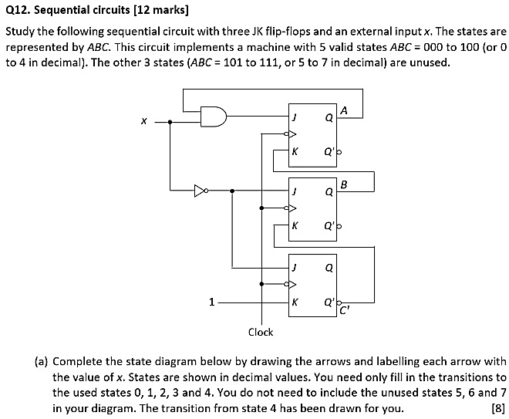
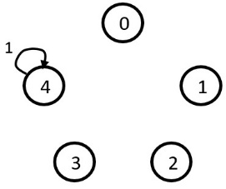
AY2020/21 Sem2 Q12
A | B | C | x | JA | KA | JB | KB | JC | KC | A+ | B+ | C+
0 | 0 | 0 | 0
0 | 0 | 0 | 1
0 | 0 | 1 | 0
0 | 0 | 1 | 1
0 | 1 | 0 | 0
0 | 1 | 0 | 1
0 | 1 | 1 | 0
0 | 1 | 1 | 1
1 | 0 | 0 | 0
1 | 0 | 0 | 1
1 | 0 | 1 | 0
1 | 0 | 1 | 1
1 | 1 | 0 | 0
1 | 1 | 0 | 1
1 | 1 | 1 | 0
1 | 1 | 1 | 1
0
0
0
0
0
0
0
0
0
1
0
1
0
1
0
1
0
0
0
0
1
1
1
1
0
0
0
0
1
1
1
1
1
0
1
0
1
0
1
0
1
0
1
0
1
0
1
0
1
1
0
0
1
1
0
0
1
1
0
0
1
1
0
0
1
0
1
0
1
0
1
0
1
0
1
0
1
0
1
0
1
1
1
1
1
1
1
1
1
1
1
1
1
1
1
1
0
0
0
0
0
0
0
0
1
1
1
1
0
0
0
0
1
0
1
0
0
0
1
1
1
0
1
0
0
0
1
1
1
0
0
0
1
0
0
0
1
0
0
0
1
0
0
0
A⋅x
JA = A⋅x
KA = B
JB = x’
KB = C’
JC = x’
KC = 1
B
1
x’
0
1
C’
x’
0
0
1
1
0,1

Slide 55
AY2020/21 Sem2 Q12
A | B | C | x | JA | KA | JB | KB | JC | KC | A+ | B+ | C+
0 | 0 | 0 | 0 | 0 | 0 | 1 | 1 | 1 | 1 | 0 | 1 | 1
0 | 0 | 0 | 1 | 0 | 0 | 0 | 1 | 0 | 1 | 0 | 0 | 0
0 | 0 | 1 | 0 | 0 | 0 | 1 | 0 | 1 | 1 | 0 | 1 | 0
0 | 0 | 1 | 1 | 0 | 0 | 0 | 0 | 0 | 1 | 0 | 0 | 0
0 | 1 | 0 | 0 | 0 | 1 | 1 | 1 | 1 | 1 | 0 | 0 | 1
0 | 1 | 0 | 1 | 0 | 1 | 0 | 1 | 0 | 1 | 0 | 0 | 0
0 | 1 | 1 | 0 | 0 | 1 | 1 | 0 | 1 | 1 | 0 | 1 | 0
0 | 1 | 1 | 1 | 0 | 1 | 0 | 0 | 0 | 1 | 0 | 1 | 0
1 | 0 | 0 | 0 | 0 | 0 | 1 | 1 | 1 | 1 | 1 | 1 | 1
1 | 0 | 0 | 1 | 1 | 0 | 0 | 1 | 0 | 1 | 1 | 0 | 0
1 | 0 | 1 | 0 | 0 | 0 | 1 | 0 | 1 | 1 | 1 | 1 | 0
1 | 0 | 1 | 1 | 1 | 0 | 0 | 0 | 0 | 1 | 1 | 0 | 0
1 | 1 | 0 | 0 | 0 | 1 | 1 | 1 | 1 | 1 | 0 | 0 | 1
1 | 1 | 0 | 1 | 1 | 1 | 0 | 1 | 0 | 1 | 0 | 0 | 0
1 | 1 | 1 | 0 | 0 | 1 | 1 | 0 | 1 | 1 | 0 | 1 | 0
1 | 1 | 1 | 1 | 1 | 1 | 0 | 0 | 0 | 1 | 0 | 1 | 0
1
0
1
JA = A⋅x
KA = B
JB = x’
KB = C’
JC = x’
KC = 1
0
0
1
0,1

Slide 56
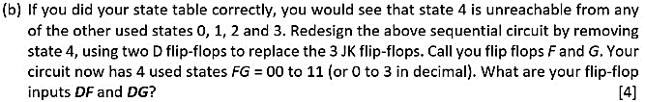
AY2020/21 Sem2 Q12
Note that Q⁺ = D for D flip-flops.
So F⁺ = DF and G⁺ = DG.
F | G | x | F⁺ | G⁺
0 | 0 | 0 | 1 | 1
0 | 0 | 1 | 0 | 0
0 | 1 | 0 | 1 | 0
0 | 1 | 1 | 0 | 0
1 | 0 | 0 | 0 | 1
1 | 0 | 1 | 0 | 0
1 | 1 | 0 | 1 | 0
1 | 1 | 1 | 1 | 0
1
0
1
DF
G
DG
G
1
0
0
1
1
0
0
0
0
0
1
F
0
0
1
1
F
1
0
0
0
0,1
x
x
DF = F’⋅x’ + F⋅G
DG = G’⋅x’

Slide 57
End of File

